Slide 1

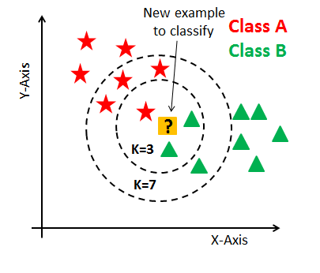
K-Nearest Neighbors

Slide 2
About:
The name of the algorithm, originates from the philosophy of kNN – i.e., people having similar mindset tend to stay close to each other.
In the same way, as a part of knn algorithm, the unknown and unlabelled data which comes for a prediction problem is judged on the basis of training data set of elements which are similar to the unknown elements.
k in kNN algorithm represents the number of nearest neighbor points which are voting for the new test data’s class.
k-NN is a type of instance-based learning, or lazy learning, where the function is only approximated locally and all computation is deferred until classification.

Slide 3
Cont..
As it calculates the distance of a new data point to all other training data points.
Euclidean is a good distance measure to use if the input variables are similar in type
(e.g. all measured widths and heights).
Manhattan distance is a good measure to use if the input variables are not similar in type
(such as age, gender, height, etc.,)
Hamming distance measures the minimum number of substitutions required to change one string into the other, or the minimum number of errors that could have transformed one string into the other.

Slide 4
Cont..
Minkowski distance is a metric in a normed vector space which can be considered as a generalization of both the Euclidean distance and the Manhattan distance.
Rescale Data: KNN performs much better if all of the data has the same scale.
Normalizing your data to the range [0, 1] is a good idea.

Slide 6
Steps :
Load the data
Initialize K to your chosen number of neighbors
For each example in the data
->Calculate the distance between the query example and the current example from the data.
->Add the distance and the index of the example to an ordered collection
Sort the ordered collection of distances and indices from smallest to largest (in ascending order) by the distances.
Pick the first K entries from the sorted collection.
Get the labels of the selected K entries, then return mode of the labels
setting K-Nearest Neighbor algorithm forms a majority vote between the K most similar instances to a given unseen observation.

Slide 7
kNN Algorithm Manual Implementation

Slide 9
Predict the T-shirt size of Anna, whose height is 161cm and his weight is 61kg.

Slide 10
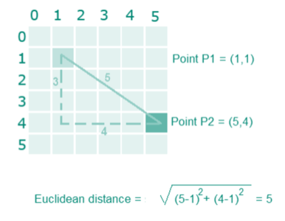
Step1: Calculate the Euclidean distance between the new point and the existing points For example, Euclidean distance between point P1(1,1) and P2(5,4) is:

Slide 12
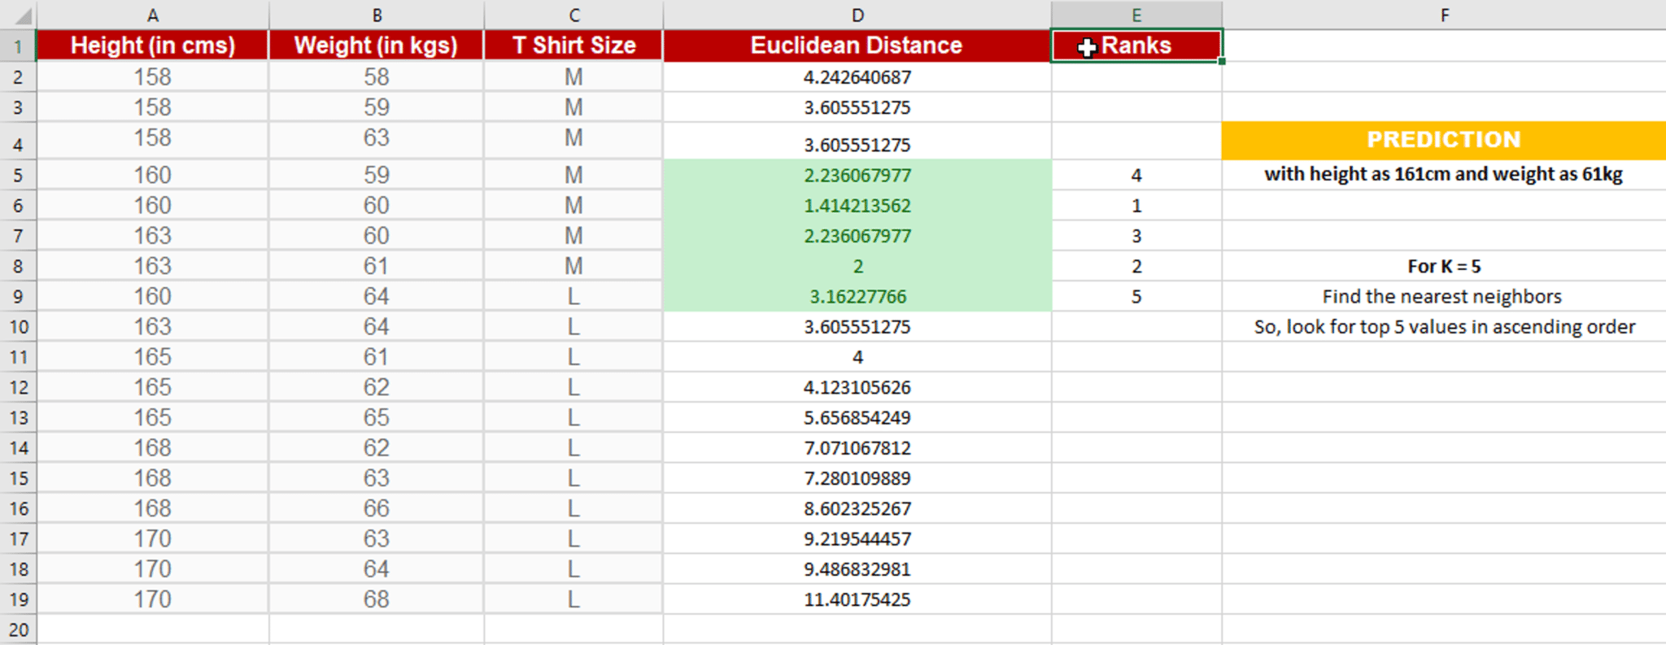
Step 2: Choose the value of K and select K neighbors closet to the new point.In this case, select the top 5 parameters having least Euclidean distance

Slide 13
Step 3: Count the votes of all the K neighbors / Predicting Values.Since for K = 5, we have 4 T-shirts of size M, therefore according to the kNN Algorithm, Anna of height 161 cm and weight, 61kg will fit into a T-shirt of size M.

Slide 14
Pros:
No assumptions about data
Simple algorithm — easy to understand
Can be used for classification and regression
Cons:
High memory requirement — All of the training data must be present in memory in order to calculate the closest K neighbors
Sensitive to irrelevant features
Sensitive to the scale of the data since we’re computing the distance to the closest K points

